Slide 1
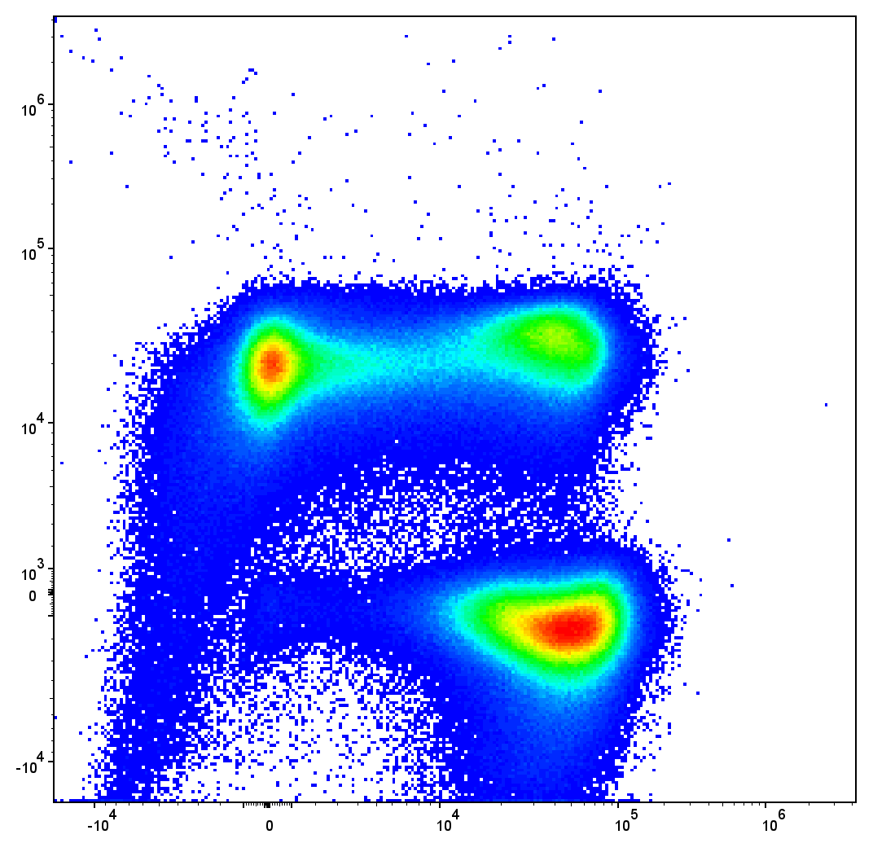
Troubleshooting unmixing controls
(both single-color and unstained)
David Rach
University of Maryland, Baltimore
June 12th, 2025

Slide 2
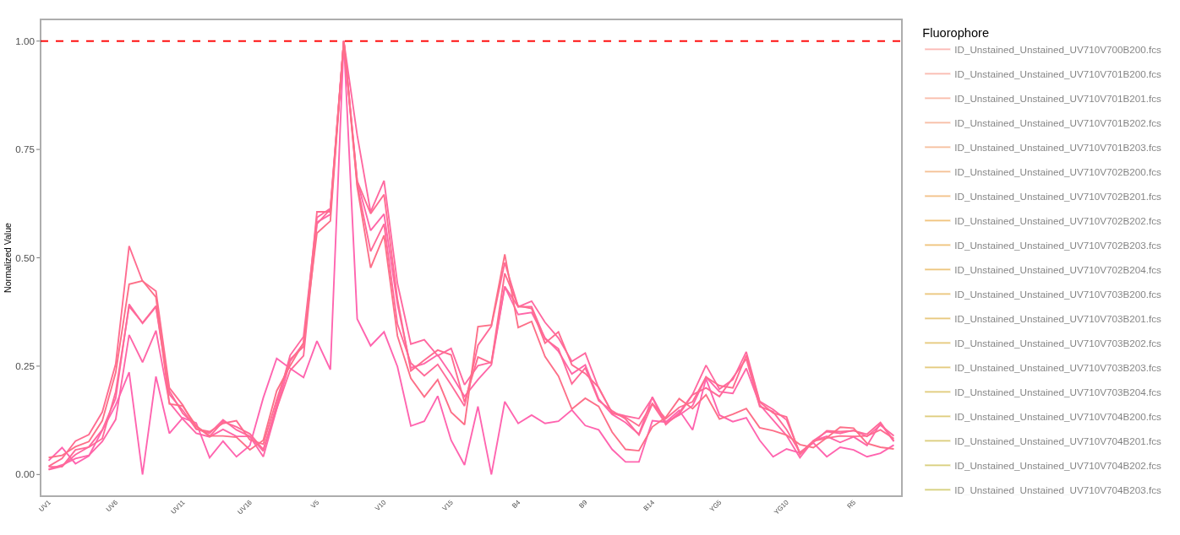
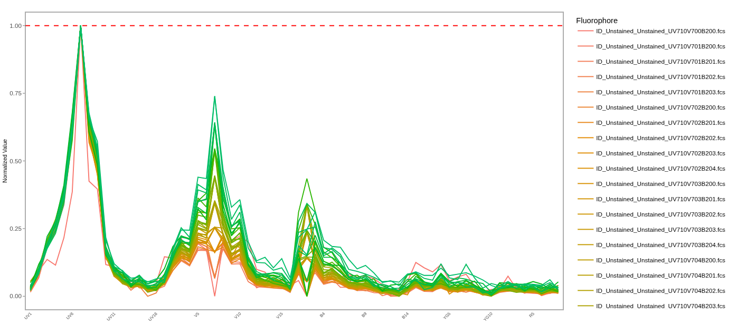
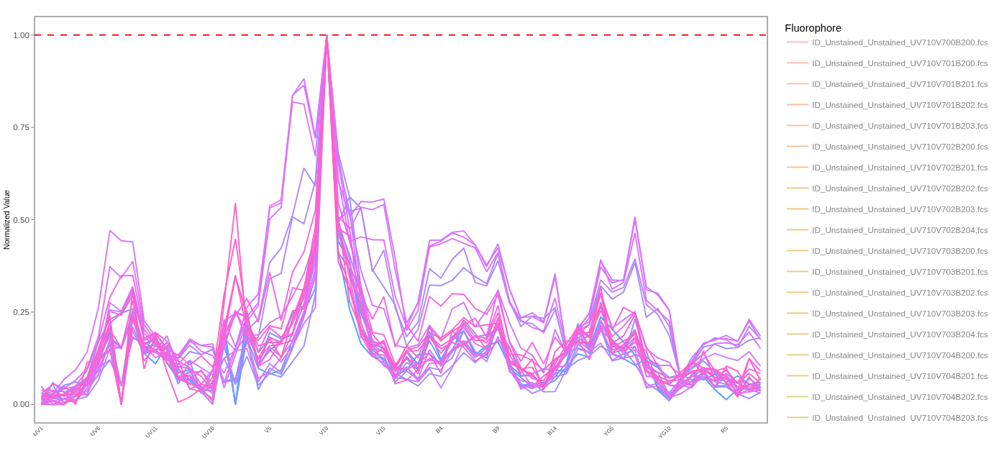
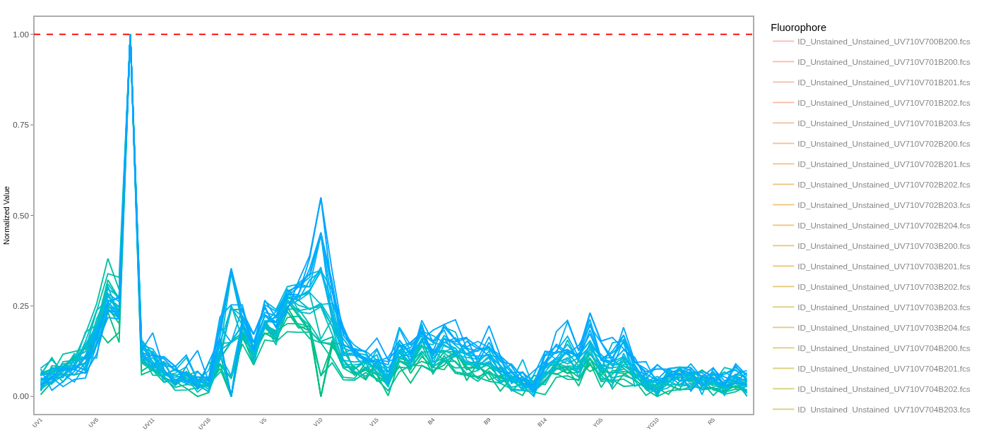

Slide 3
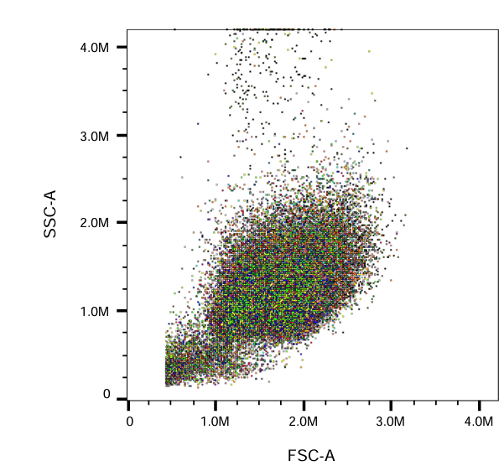
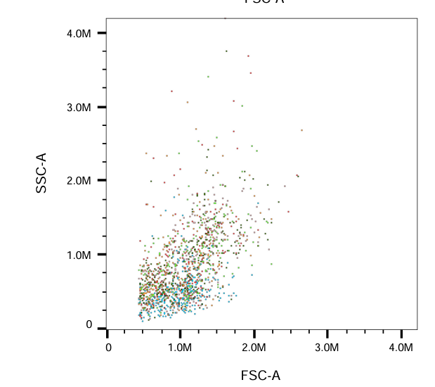
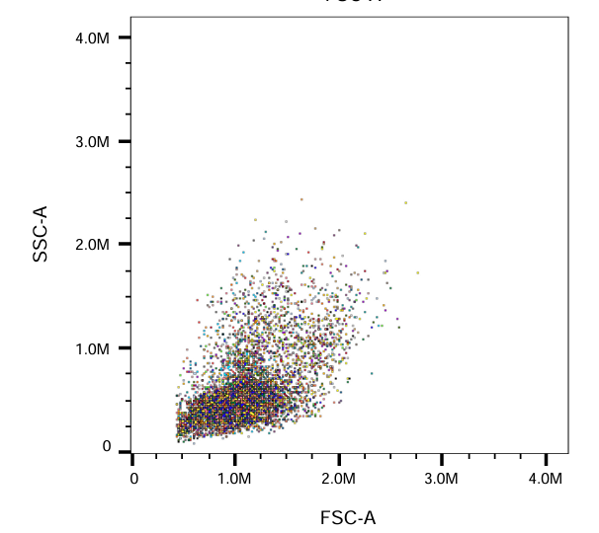
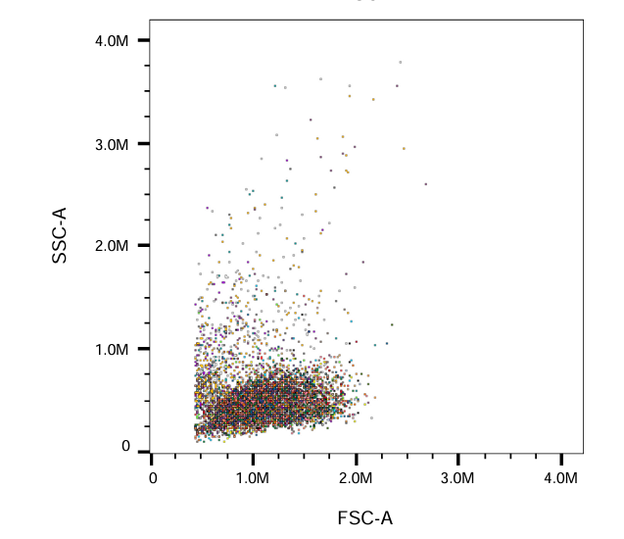

Slide 4
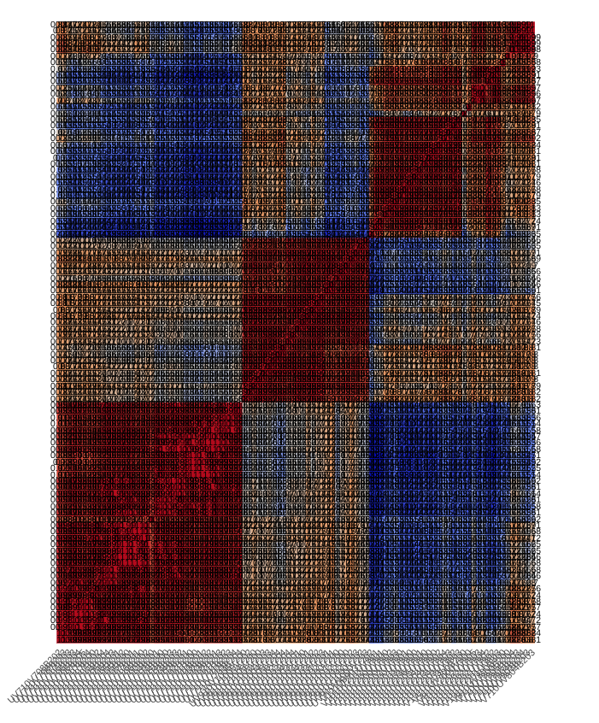

Slide 5
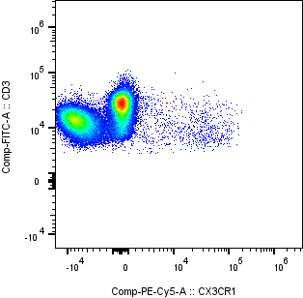
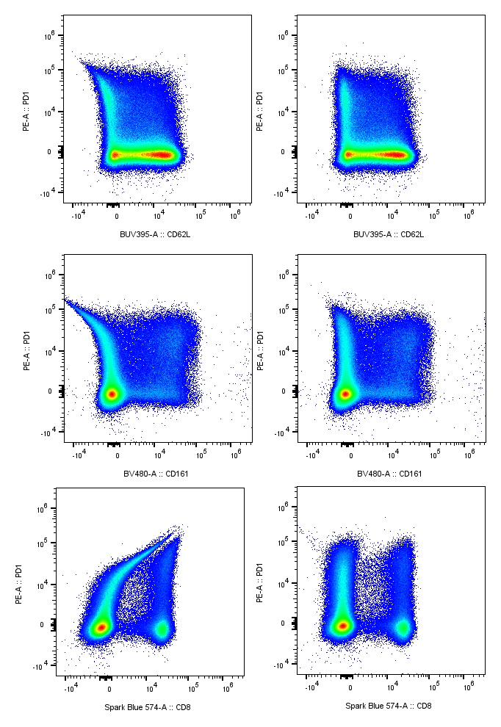
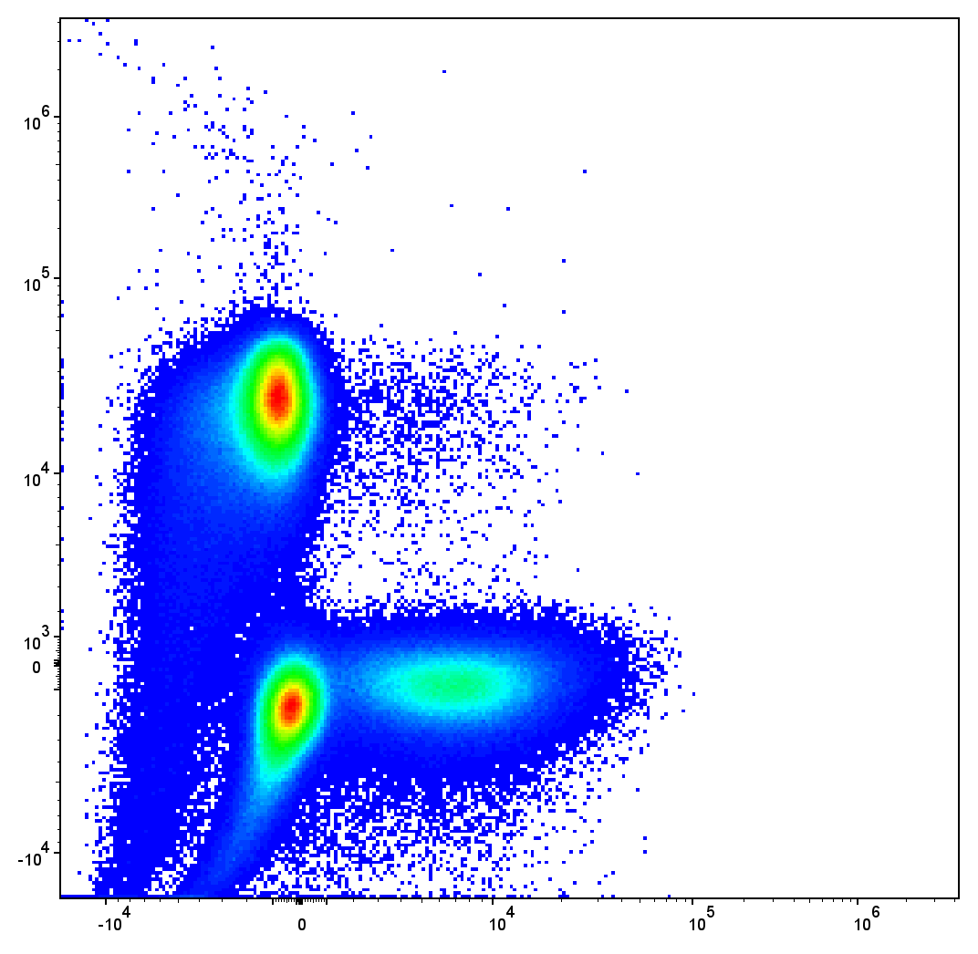
You have encountered an unmixing error (s)
What do you do next?

Slide 6

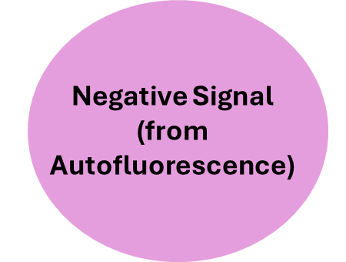
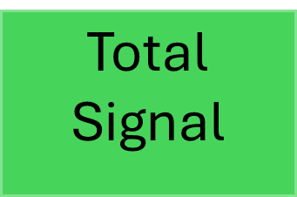
Unmixing errors occur when:
=
+
Fluorescent signature of your unmixing control doesn’t match the fluorescent signature of that same fluorophore on your full-stained sample

Slide 7
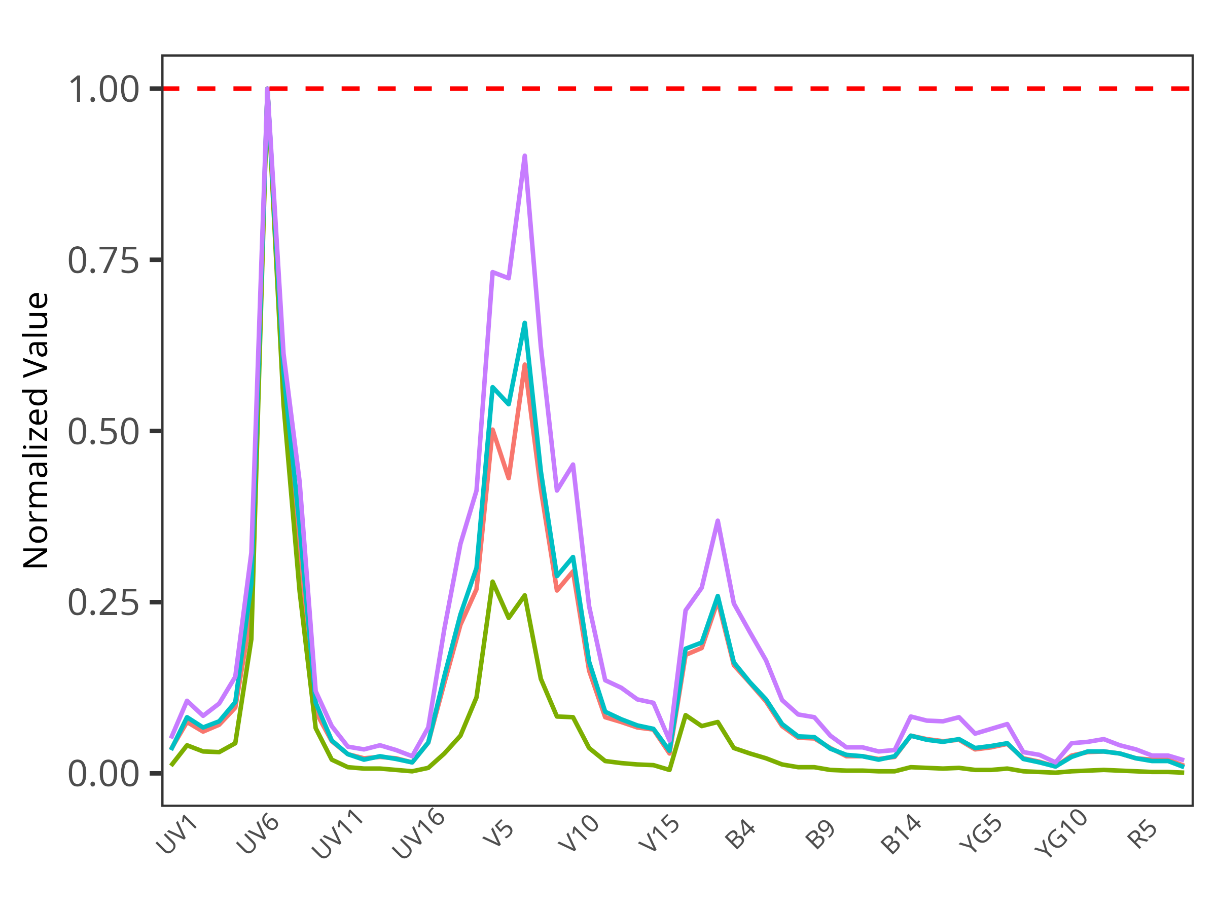
Unmixing errors occur when:
=
+
Fluorescent signature of your unmixing control doesn’t match the fluorescent signature of that same fluorophore on your full-stained sample

Slide 8
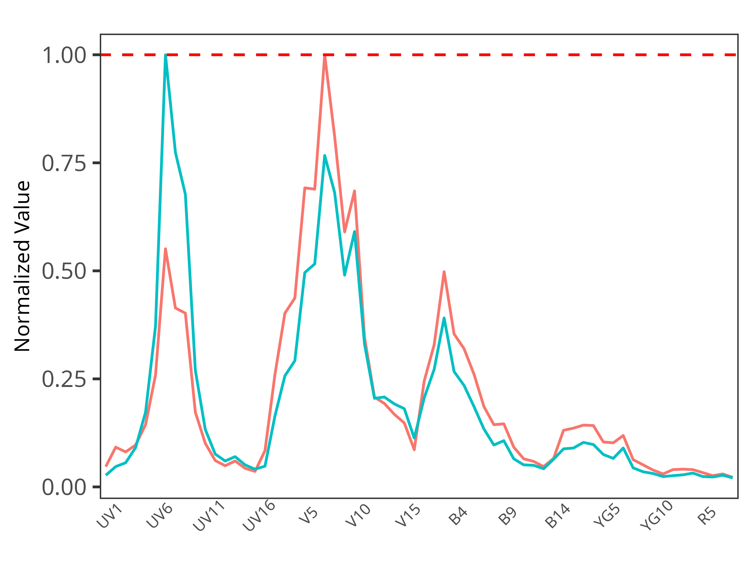
Unmixing errors occur when:
=
+
Fluorescent signature of your unmixing control doesn’t match the fluorescent signature of that same fluorophore on your full-stained sample

Slide 9
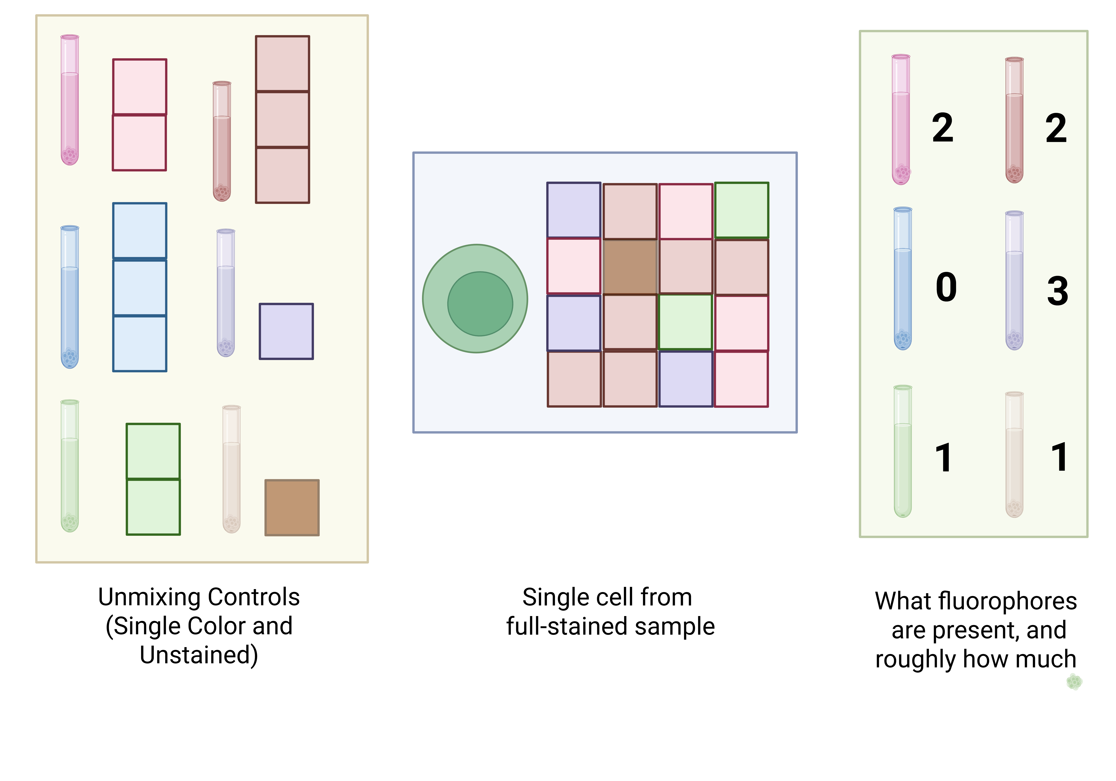
With a successful unmixing

Slide 10
With a successful unmixing

Slide 11
With a successful unmixing

Slide 12
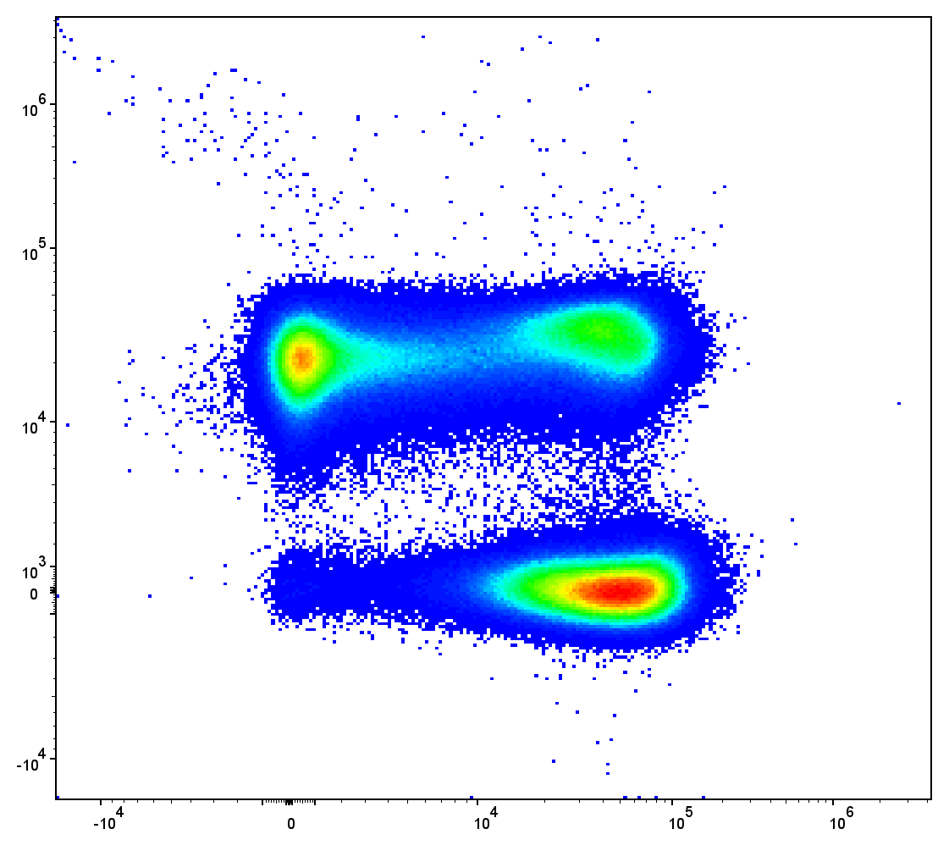
With a successful unmixing
Spark Blue 550 :: CD3
BV510 :: CD45RA

Slide 13
Unmixing errors occur when:
=
+
Fluorescent signature of your unmixing control doesn’t match the fluorescent signature of that same fluorophore on your full-stained sample

Slide 14
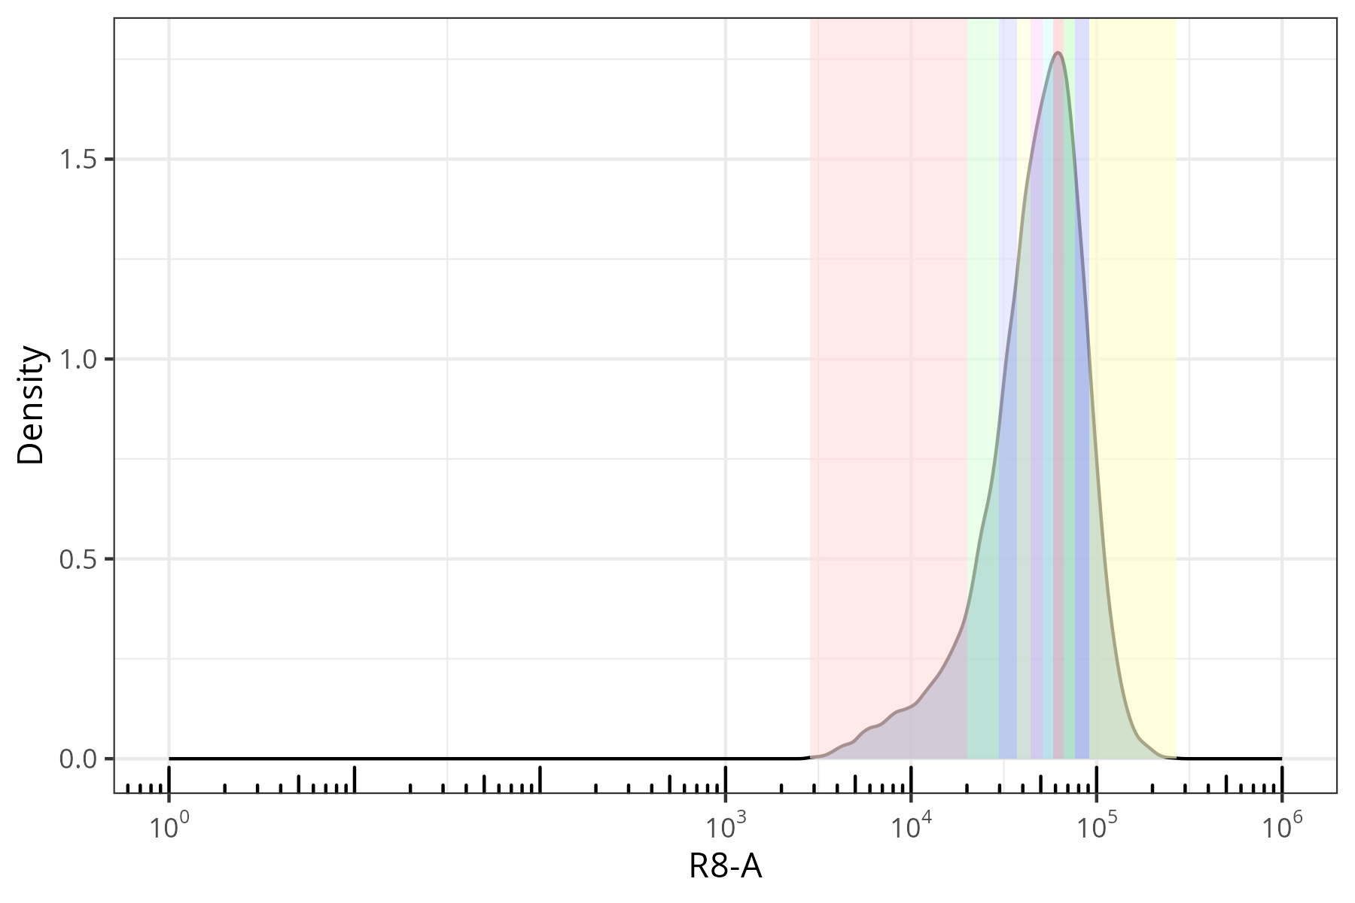
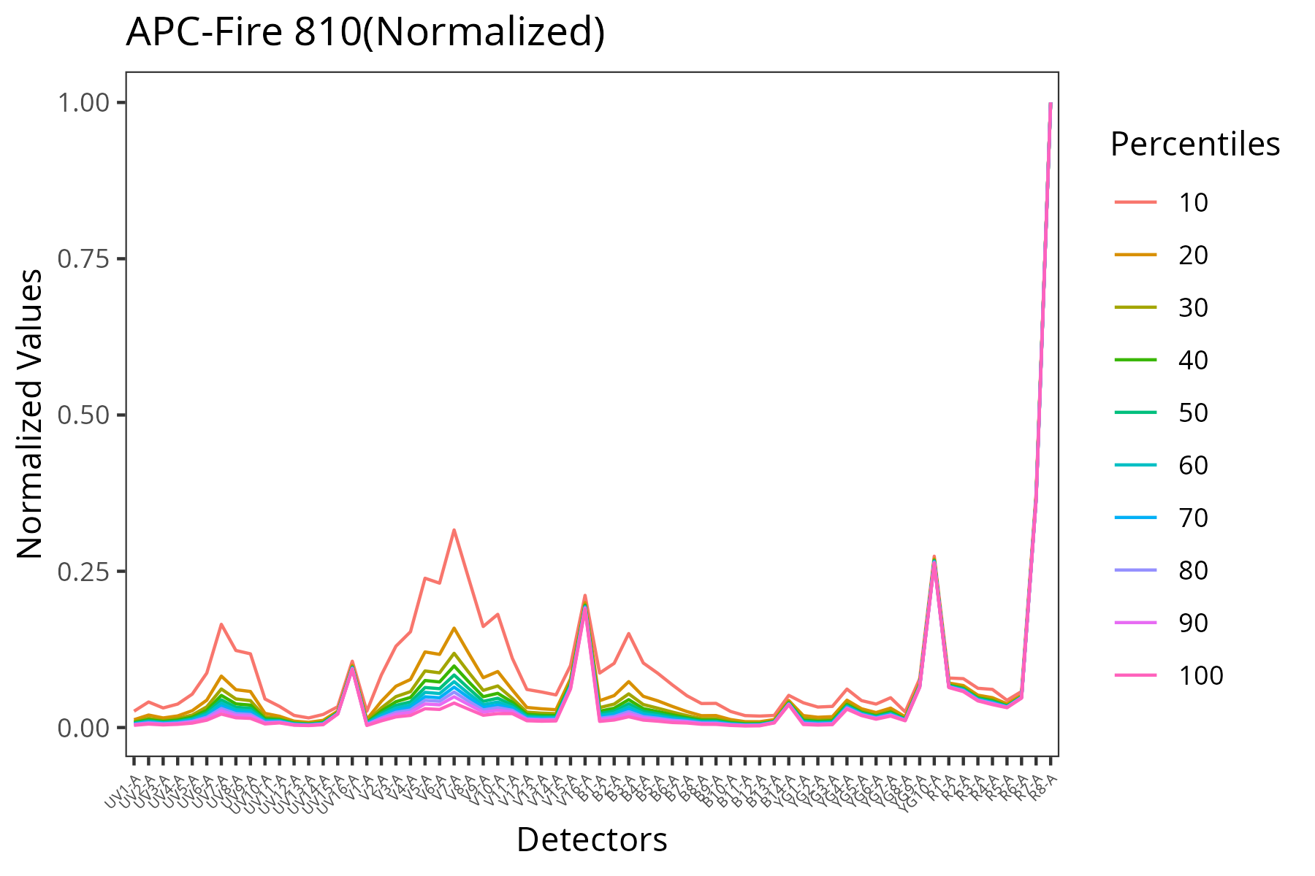
If you set a gate incorrectly

Slide 15
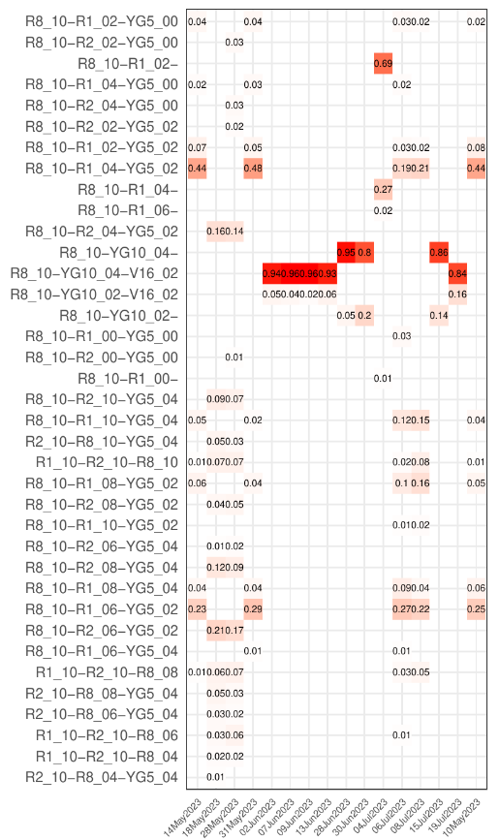
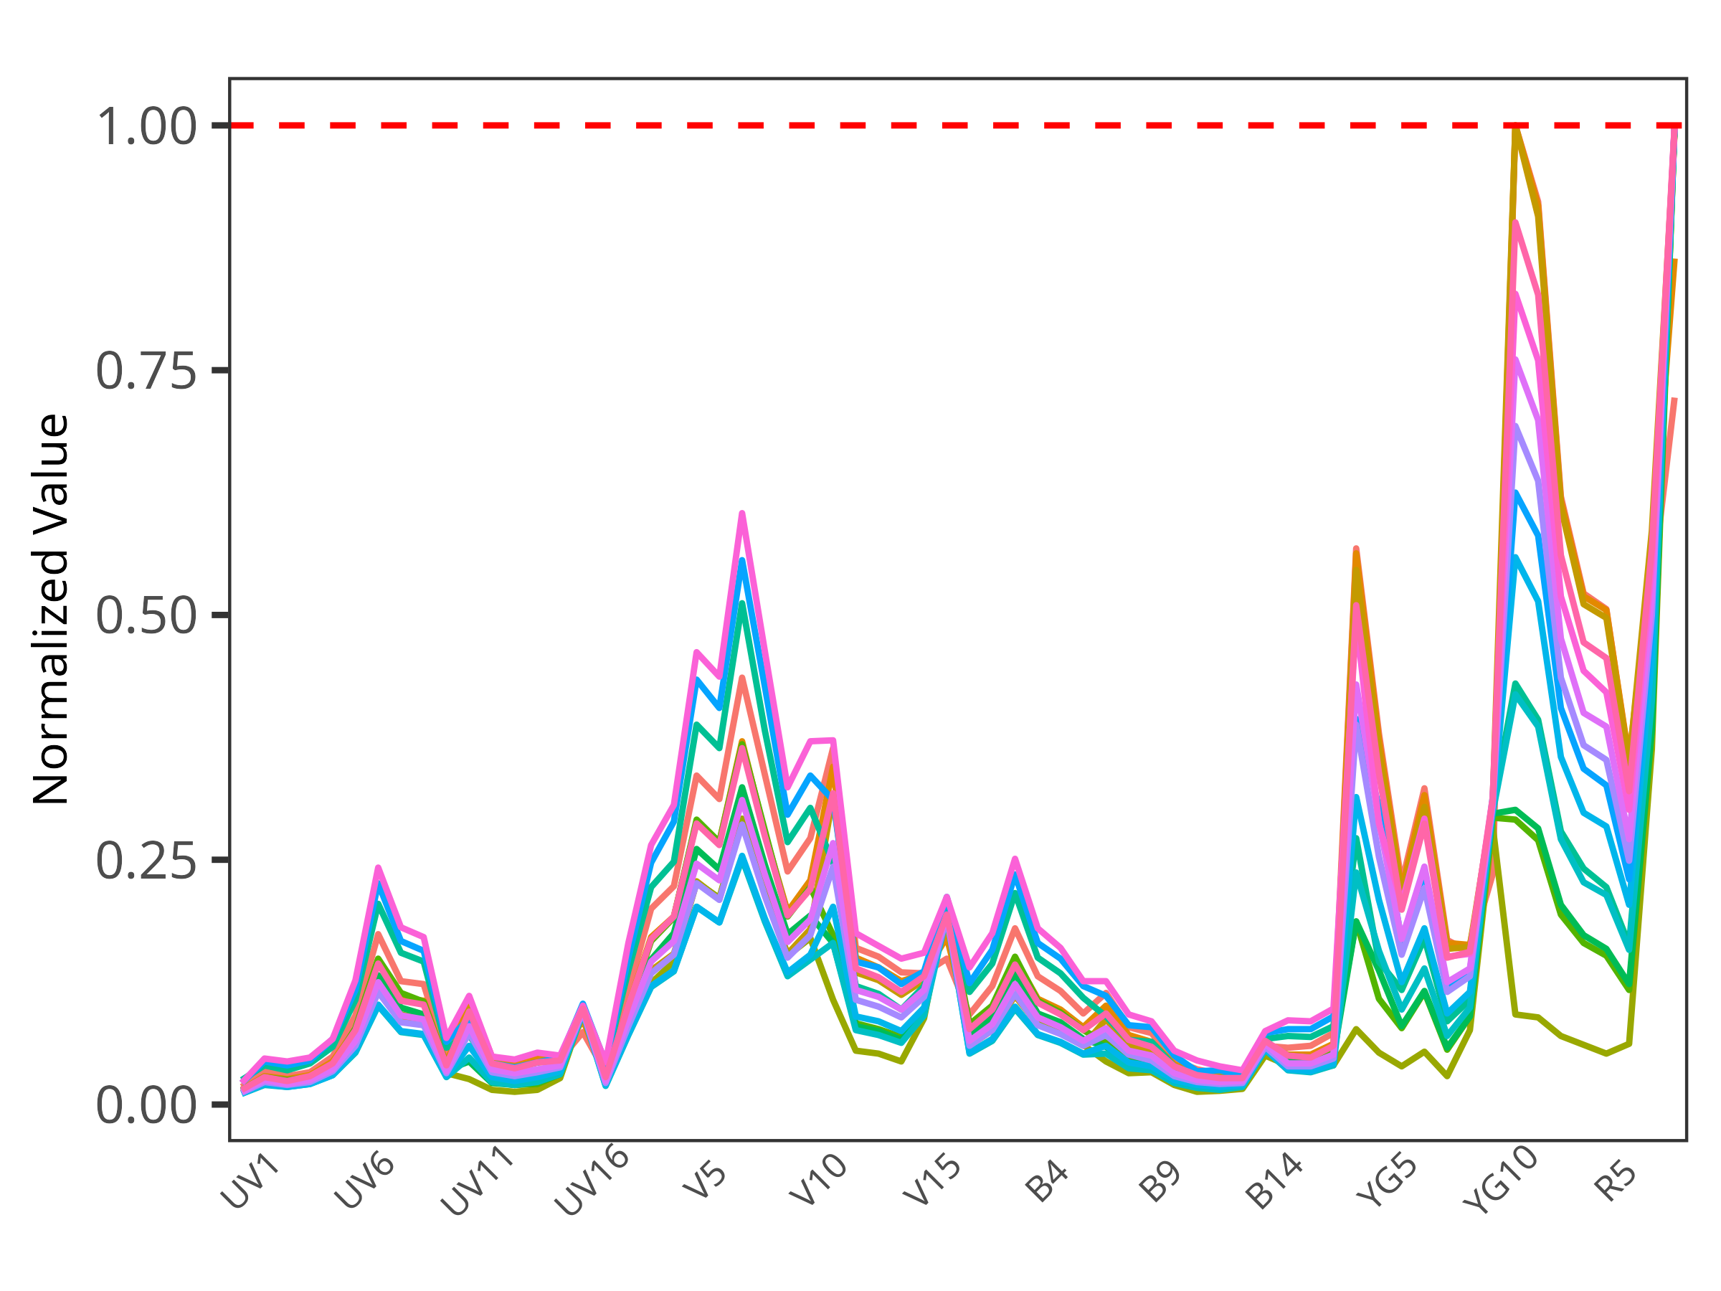
Or have a tandem-fluorophore degrade

Slide 16
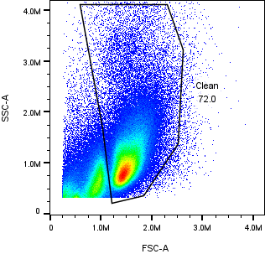
Or set our unstained on the wrong cell population

Slide 17
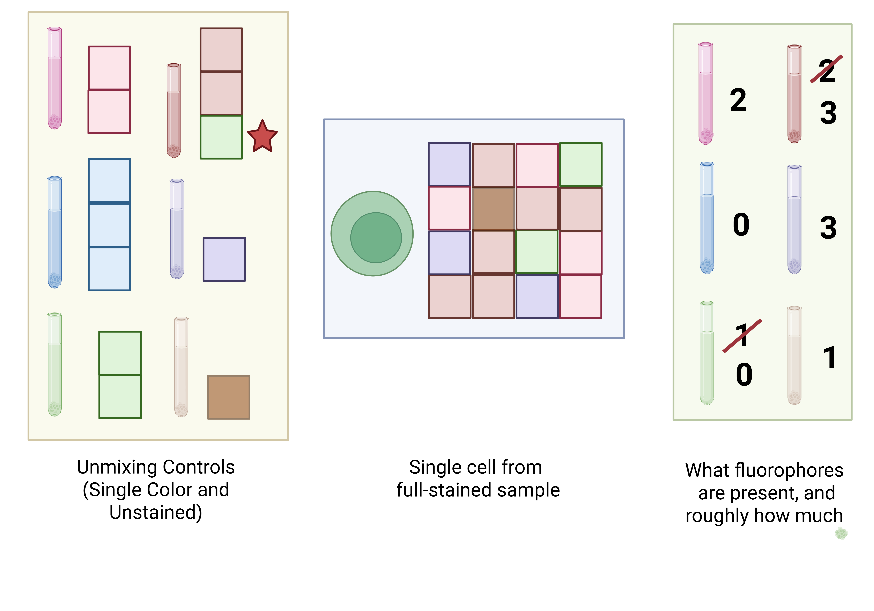
With an unsuccessful unmixing

Slide 18
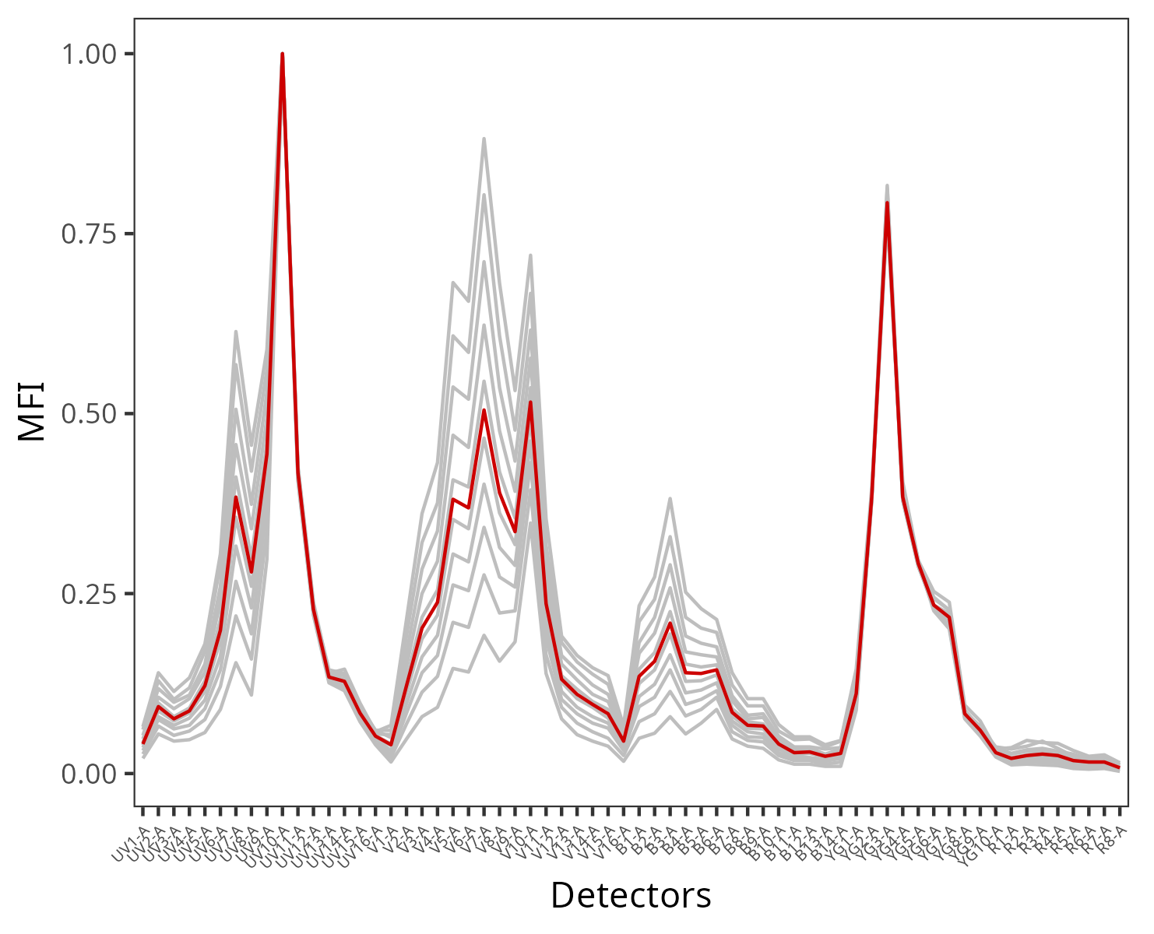
We introduce uncertainty into the calculation
=
+

Slide 19
With an unsuccessful unmixing

Slide 20
With an unsuccessful unmixing

Slide 21
With an unsuccessful unmixing

Slide 22
With a unsuccessful unmixing
Spark Blue 550 :: CD3
Spark Blue 550 :: CD3
BV510 :: CD45RA
BV510 :: CD45RA

Slide 23
How do we efficiently figure out what is causing
the unmixing issue?

Slide 24
1) Identify the problem fluorophores

Slide 25
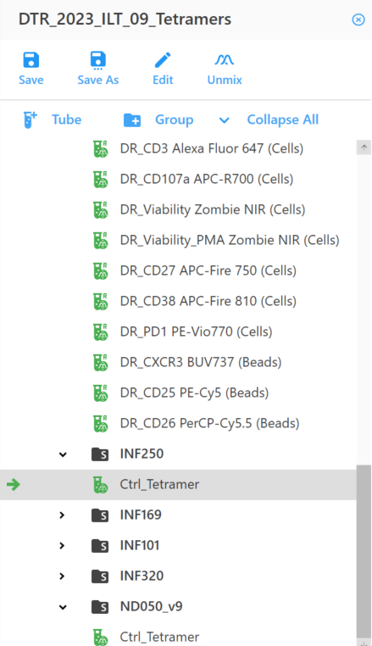
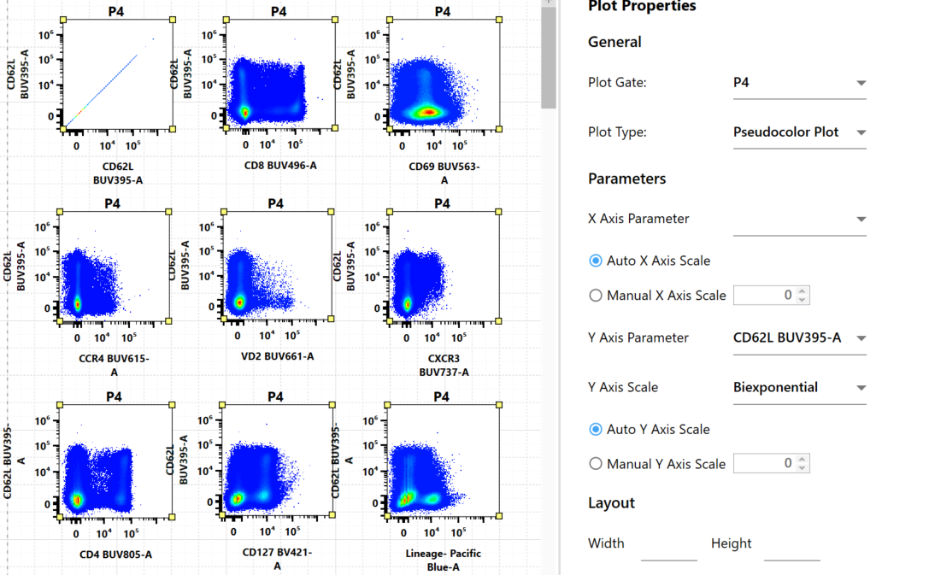
Check the full-stained samples 1xN plots
What fluorophores are having issues?
What cell subsets are affected?
How prevalent are they?

Slide 26
Check the full-stained samples 1xN plots
What fluorophores are having issues?
What cell subsets are affected?
How prevalent are they?

Slide 27
Alternatively: Gate cell population subsets,
and visualize marker distributions

Slide 28
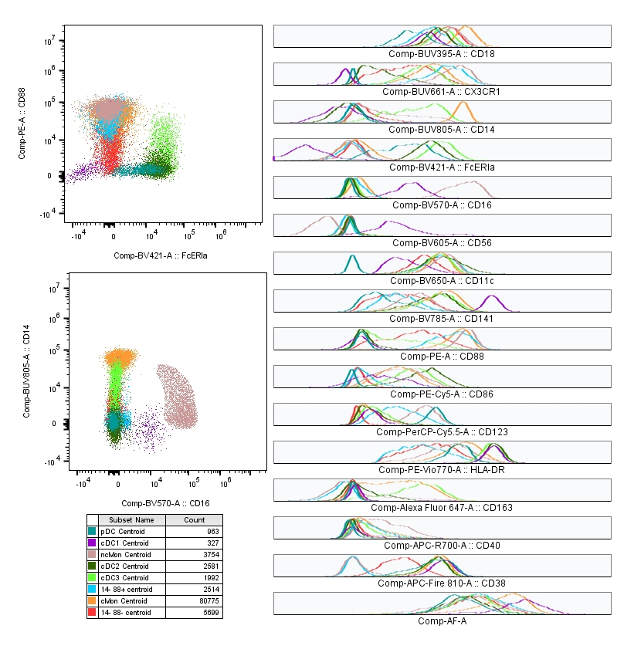
Highly-negative populations

Slide 29
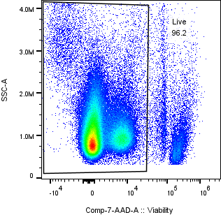
After gating out dead cells and debris

Slide 30
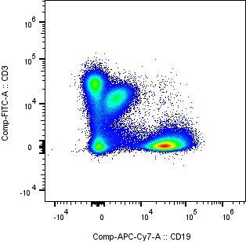
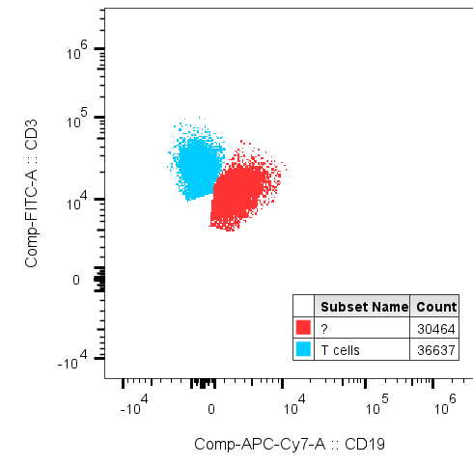
Ending up with two CD3+ populations

Slide 31
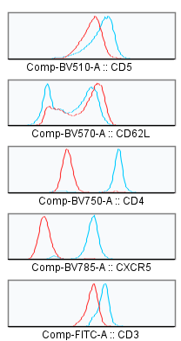
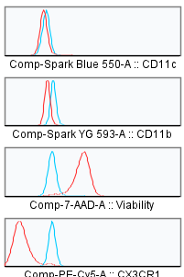
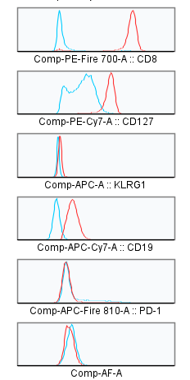
Visualizing both by Histograms

Slide 32
Note super-negative events
Super-negative events

Slide 33
Visualizing these markers by pseudocolor

Slide 34
Note subset specific primary markers
Note which primary markers with good staining (negative at 0, positive 10^4) fully separate between the populations

Slide 35
Note slight-positive events
Slight-positive events

Slide 36
Our markers of interest
The populations seem to be split between CD4+ and CD8+ T cells.
The super-negative fluorophores are:
BV785 and PE-Cy5
The slightly positive markers are:
FITC, 7-AAD, APC-Cy7

Slide 37
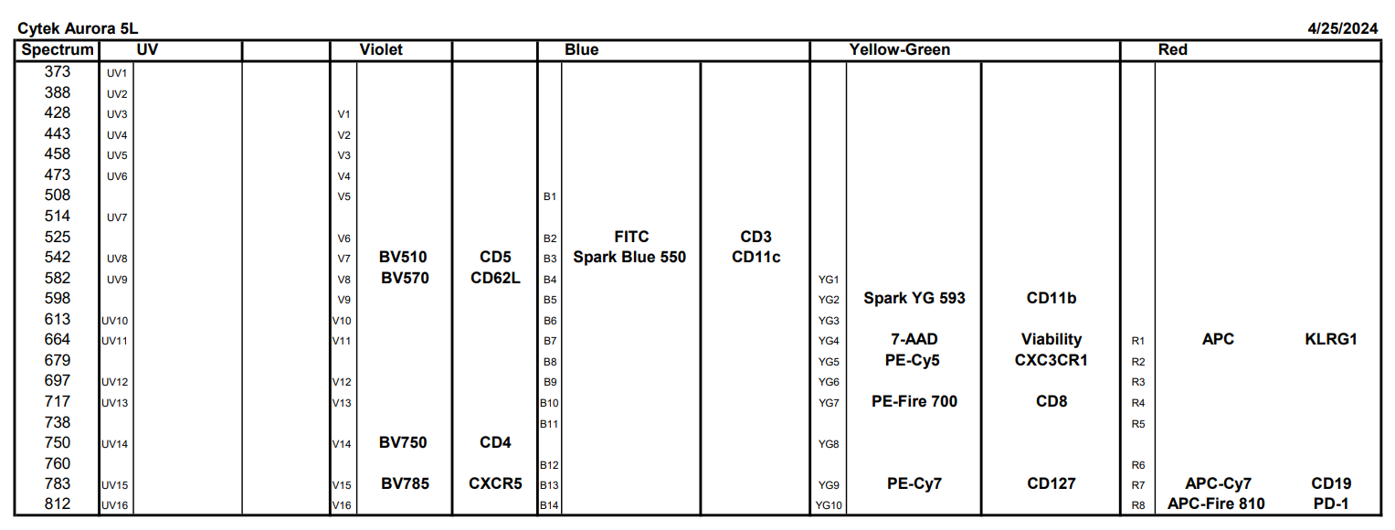
Which fluorophore is actually drivingthe unmixing issue?

Slide 38
Three main types of fluorophore interactions
1. Intra-Laser
2. Inter-Laser
3. Tandem

Slide 39
Intra-Laser
Fluorescent signature plots and Cosine (Similarity) matrix are good proxies to identify fluorophores with extensive overlap.

Slide 40
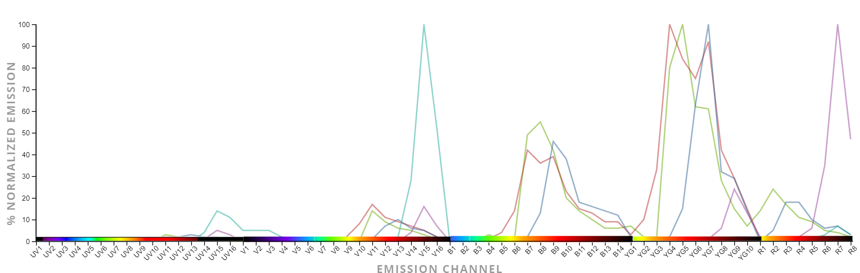
Same information viewed differently

Slide 41
Inter-Laser
Fluorophores have emission peaks across multiple lasers. Check on a by laser basis the equivalent wavelength

Slide 42
Tandems
Leaf-frogging
Tandem dyes (especially if degrading) can cause issues on the parent fluorophore

Slide 43
Intra-Laser for our panel
Spectral Overlap and Cosine Similarity Matrix are good proxies to identify the extent

Slide 44
Inter-Laser
Fluorophores have emission peaks across multiple lasers. Check on a by laser basis the equivalent wavelength

Slide 45


If there were a Tandem Issue
Leaf-frogging
Tandem dyes (especially if degrading) can cause issues on the parent fluorophore

Slide 46
What are you doing with your data?
Automated gating
Manual gating
Unsupervised Analysis
Supervised Analysis
Model Organisms
Clinical Samples
Blood
Tissue
Generalized Panel
(few co-expressed markers)
Targeted Panel
(many co-expressed markers)
A single cell population
of interest
If the tiniest T cell subset sneezes, you want to know about it

Slide 47


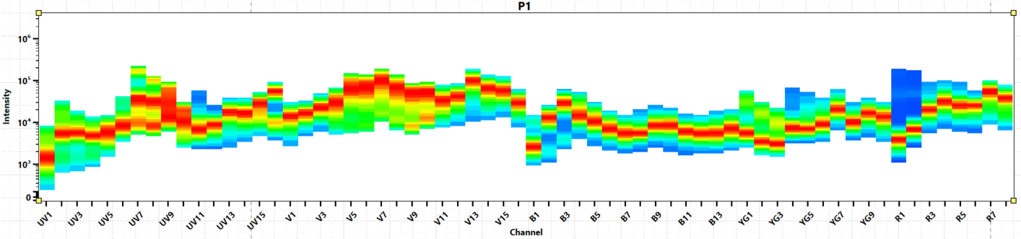





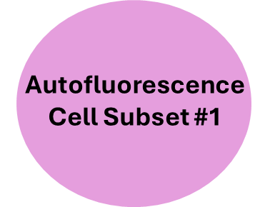
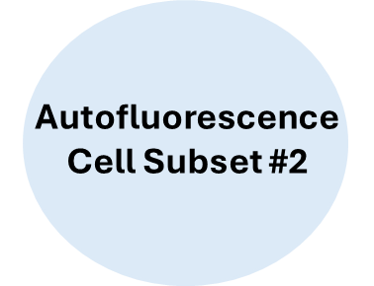
A spectral cytometer needs three things
for successful unmixing:
Single-color
Reference Controls
Unstained
Reference Controls

Slide 48


The four rules for good unmixing controls
The single stained control must be as bright or brighter than the fully stained sample.
The exact same fluorophore must be used the stain the control and the fully stained sample.
Background autofluorescence should be the same for the positive and negative control
Enough Events
https://voices.uchicago.edu/ucflow/flow-cytometry-resources/

Slide 49
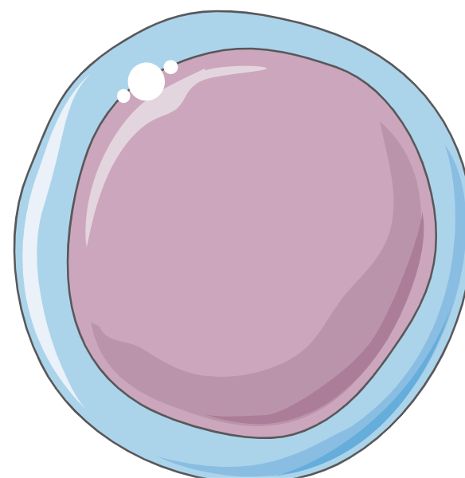
The issue: Variation in autofluorescence
Difference in cell size:
Same proportion of autofluorescent molecules, but because one cell is larger, more of them overall, thus brighter
Difference in amount of autofluorescence:
Same cell size, just one has more autofluorescent molecules, thus brighter
Variation in autofluorescent molecules:
Same cell size, but express different mixture of autofluorescent molecules, resulting in a different autofluorescent signature

Slide 50
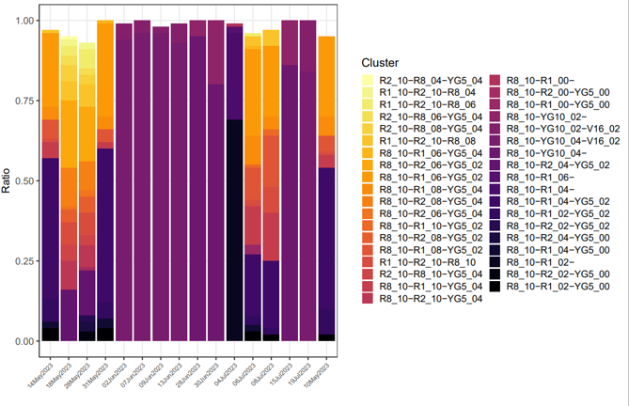
Your fluorophores can also vary in their signature!!!
Manufacturer Lot Variation
Cross-pollinating BUV and BV fluorophores
Monocytes eating PE and
APC tandem dyes
Tandem degradation
FRET
And others!

Slide 51
You encounter unmixing errors….
BUV and BV dye
cross-pollination
Tandem degradation
Hungry Monocytes
Autofluorescence
Spreading Errors

Slide 52
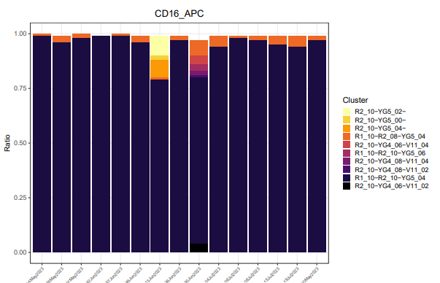
Many Fluorophores Quite Stable

Slide 53
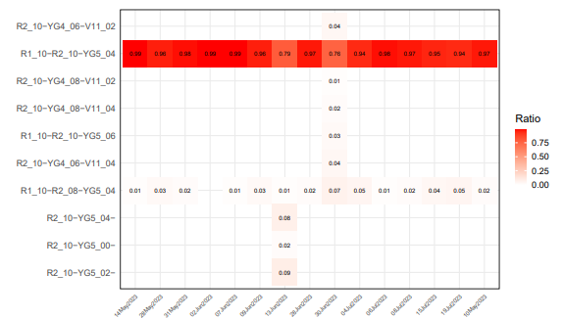
Many Fluorophores Quite Stable

Slide 54
Tandem dyes
BV
PE
Fire750
Fire810
PerCP
Cy5.5
APC
Cy7

Slide 55
Tandem dyes
711
BV
Cy7
PE
Fire750
Cy5.5
APC
PerCP

Slide 56
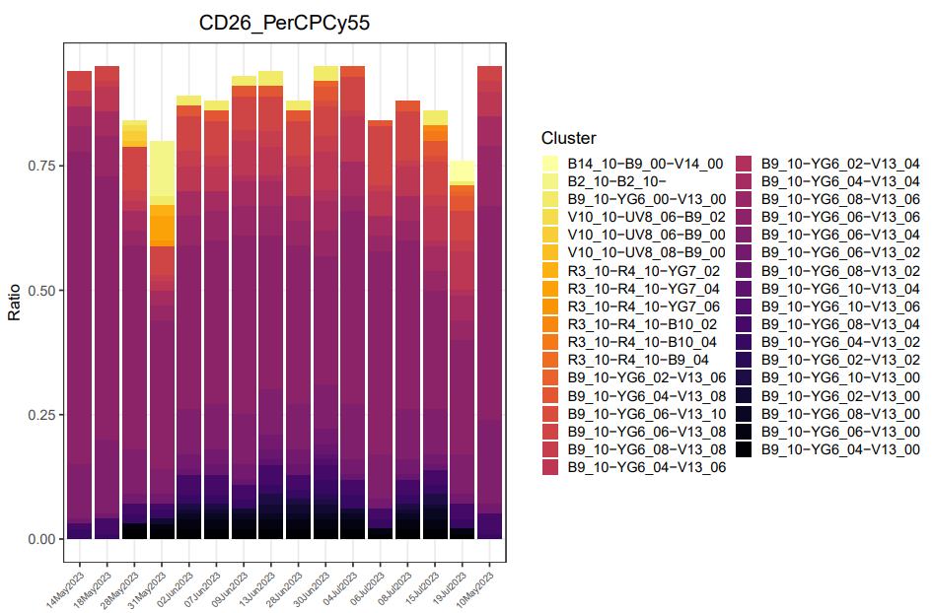
Others are susceptible to degradation

Slide 57
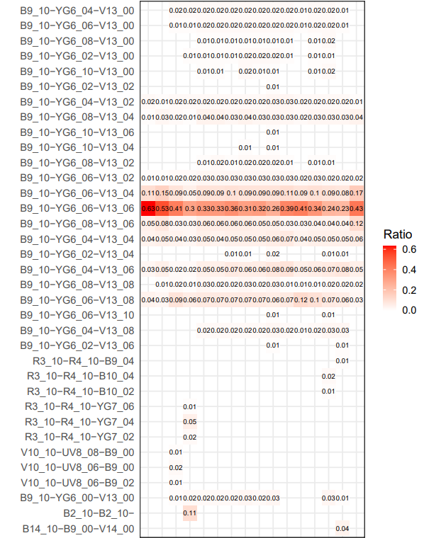
Others are susceptible to degradation

Slide 58
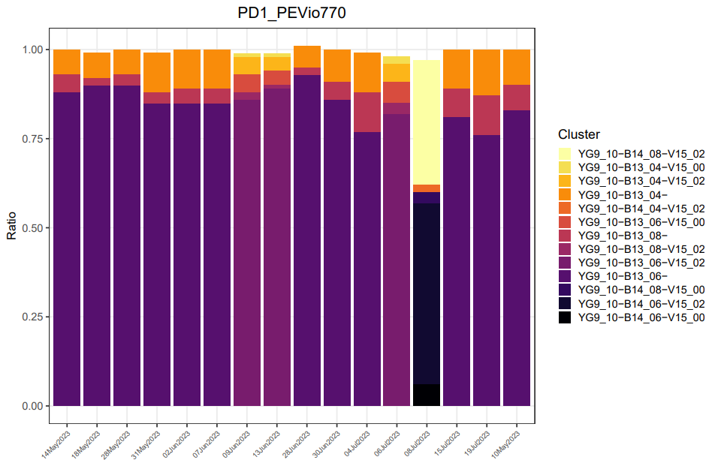
Tandem degradation

Slide 59
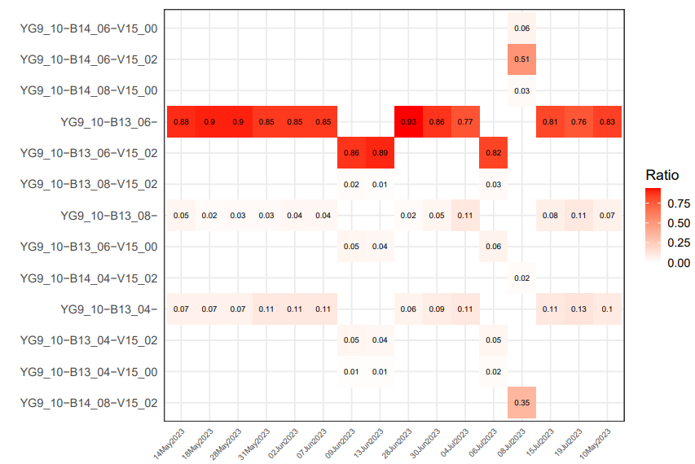
Tandem degradation

Slide 60
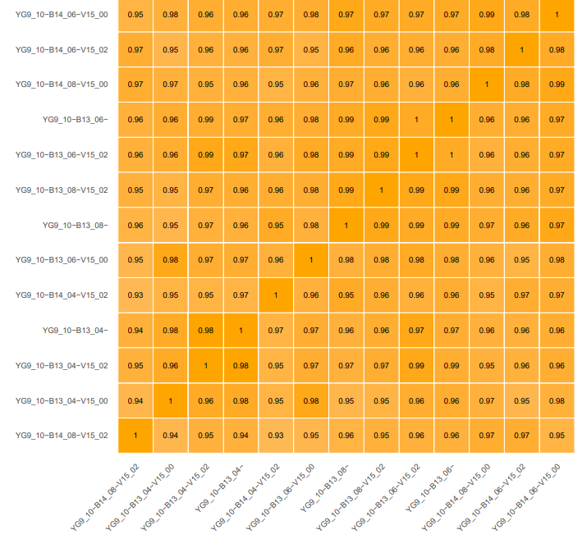
Tandem degradation

Slide 61
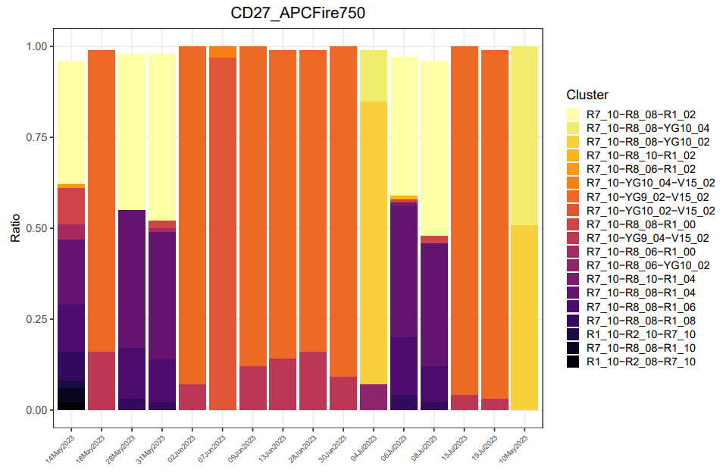
Tandem degradation

Slide 62

Tandem degradation

Slide 63

Tandem degradation

Slide 64

Tandem degradation

Slide 65

Tandem degradation

Slide 66




Tandem degradation

Slide 67
The main issue with tandem degradation:
Fire750
Fire810
Single Color Controls
APC
APC
APC
CD16
CD27
CD38

Slide 68
The main issue with tandem degradation:
Fire750
Fire810
Single Color Controls
APC
APC
APC
CD16
CD27
CD38
Fire750
APC
Fire750
+
APC
APC
CD27
CD27
CD27

Slide 69
The main issue with tandem degradation:
Fire750
Fire810
Single Color Controls
APC
APC
APC
CD16
CD27
CD38
Fire810
APC
Fire750
CD38
+
APC
Fire750
+
APC
APC
APC
CD27
CD27
CD27
CD38

Slide 70

Tandem Degradation affecting your
single-color stains

Slide 71
Tandem Degradation affecting your
single-color stains

Slide 72
BUV & BV Dyes: Cross-pollinating
711
570
750
BV
BV
BV
650
786
BV
BV
605
BV

Slide 73






BUV & BV Dyes: Cross-pollinating
711
570
750
BV
BV
BV
650
786
BV
BV
605
BV

Slide 74

PE and APC Dyes: Hungry Monocytes
Fire750
Cy7
APC
PE

Slide 75

Yellow and Red Fluors: Bad spreading errors
Cy7
PE
Fire750
APC
https://voices.uchicago.edu/ucflow/2020/03/04/understanding-the-trumpet-effect-how-to-design-aurora-panels-around-spreading-error/

Slide 76

Violet: Autofluorescence Issues
UV
V
B

Slide 77
Check your NxN plots for full-stained samples!
What fluorophores are having issues? What cell subsets are affected? How prevalent are they?

Slide 78


Check your single-color cell controls!
Are they unmixing correctly?

Slide 79
Check your single-color cell controls!
If the cell single-color controls are fish-tailing after unmixing with beads, using beads as the single-color controls won’t work for unmixing cells.

Slide 80
If all your cell single color controls are okay,
But your full-stained samples are having issues:

Slide 81
Check the brightness of your single-color control
Locate what value on the axis the brightest cells in your single-color controls are located at.

Slide 82
Then compare where the brightest cells in your full-stained sample are at for that fluorophore
Are they roughly similar, or is the full-stained sample brighter?

Slide 83
Why does the brightness of the full-stained sample matter?
There are several hand-wavy theories

Slide 84

Possible explanations:
Brighter Single Colors -> Unique Signature

Slide 85

Possible explanations:
Brighter Single Colors -> Unique Signature
2) Extrapolation Issues
10x3
10x4
10x5
10x6

Slide 86

Possible explanations:
Brighter Single Colors -> Unique Signature
2) Extrapolation Issues
Input corresponds to a certain amount of photons being detected from single-color control
Value
10x3
10x4
10x5
10x6

Slide 87

Possible explanations:
Brighter Single Colors -> Unique Signature
2) Extrapolation Issues
Input corresponds to a certain amount of photons being detected from single-color control
A similar amount of detected photons is a set-point for the full-stained sample
Value
10x3
10x4
10x5
10x6

Slide 88

Possible explanations:
Brighter Single Colors -> Unique Signature
2) Extrapolation Issues
Input corresponds to a certain amount of photons being detected from single-color control
A similar amount of detected photons is a set-point for the full-stained sample
Value
10x3
10x4
10x5
10x6

Slide 89


Possible explanations:
Brighter Single Colors -> Unique Signature
2) Extrapolation Issues
Input corresponds to a certain amount of photons being detected from single-color control
A similar amount of detected photons is a set-point for the full-stained sample
Presence of larger values than expected
throws off unmixing
Value
10x3
10x4
10x5
10x6

Slide 90


Possible explanations:
Brighter Single Colors -> Unique Signature
Value
2) Extrapolation Issues
10x3
10x4
10x5
10x6
3) More representative

Slide 91
Brighter cells more representative on average
Angle of the different vectors differs

Slide 92

Changing MFI values of single-color control
can impact the unmixing:
Single-color matrix values kept at 100% of original value
Single-color Matrix Values changed
to 10% of original value

Slide 93


Artefact of Biexponential Transformation?
Unmixed Data
Biexponentially Transformed
Positive staining cells are bright and measurements are in logs.
Negative staining cells have linear values
A scaling/transformation is applied to the data to give us the plots we see.
The scaling can also exacerbate certain types of unmixing errors.

Slide 94
The tool of first resort: Troubleshooting your single-color controls
Increase the MFI of your staining for the single colors
Test the differences between using cells or beads
Choices: Library; Duplicate with experiment; new single colors each time.
Swap in CD3/CD4 for the same fluorophore (from same manufacturer).
Once optimized, maintain consistent unmixing throughout an experiment run.

Slide 95

The tool of last resort: Compensation
Spectral Flow Cytometry is not Conventional Flow Cytometry.
Best practice papers actively discourage it (see math discussion)
If your reference controls are bad from the get-go, it is not going to save your data.
That being said: Sometimes is needed.

Slide 96
The tool of last resort: Compensation
Spectral Flow Cytometry is not Conventional Flow Cytometry.
Best practice papers actively discourage it (see math discussion)
If your reference controls are bad from the get-go, it is not going to save your data.
That being said: Sometimes is needed.
If you are going to do it, I advocate the build the compensation matrix
from your cell single-color controls and then apply it to the full-stained samples

Slide 97


To what are you applying compensation?
Adjust spillover on the individual cell single color controls after unmixing
You see the unmixing error on a single-stained sample, and the effect of the adjustment as visualized on an NxN plot.
By saving and importing spillover to each single color sequentially, you build a full compensation matrix for all combinations in your panel
This can then be applied to the full-stained sample
Can be saved to library for reuse to correct specific panel issues.
Reproducible

Slide 98

How to do this:
On your unmixed experiment, identify the cell single color control with unmixing issues
Right click on the single color, select Edit Properties

Slide 99

How to do this:
Click on Spillover
Click Enable Compensation
Slide the window out of the way

Slide 100

How to do this:
Click on the Spillover matrix button
Target the most “uncompensated” fishtail appearances first
Click and drag in the direction you want to shift the population until vertical/horizontal
Observe effect of the intervention on other NxN plots

Slide 101
How to do this:
Once done with adjustments to the individual single-color, click save on this screen.

Slide 102

How to do this:
Right click and copy the saved spillover from the first single color.
Navigate to the next single color with issues and paste the spillover.
Repeat the process until full compensation matrix is assembled.

Slide 103

How to do this:
Save the assembled compensation matrix specific to your single-color controls to either a file or the library.
Apply this compensation matrix to your full-stained samples by right clicking on the sample and importing spillover .

Slide 104
Why not just directly apply to the full-stained sample?
Adjust spillover on the individual cell single color controls after unmixing
Adjust spillover on your full-stained sample after unmixing
You know exactly what needs adjustment, and can visually effect on an NxN plot.
By importing spillover to each single
single color sequentially, you build a compensation matrix that can be saved to library to correct specific panel issues.

Slide 105











30-color panel with high co-expression
Normal compensation
NxN plot

Slide 106











30-color panel with high co-expression
Normal compensation

Slide 107





30-color panel with high co-expression
Normal compensation

Slide 108





30-color panel with high co-expression
Normal compensation

Slide 109
30-color panel with high co-expression
Normal compensation

Slide 110
The issue: Variation in autofluorescence
Difference in cell size:
Same proportion of autofluorescent molecules, but because one cell is larger, more of them overall, thus brighter
Difference in amount of autofluorescence:
Same cell size, just one has more autofluorescent molecules, thus brighter
Variation in autofluorescent molecules:
Same cell size, but express different mixture of autofluorescent molecules, resulting in a different autofluorescent signature

Slide 111
Autofluorescence is both a concern for single-colors, but importantly also full-stained sample
Single-color
Reference Controls
Unstained
Reference Controls

Slide 112

Autofluorescence can differ between individuals and treatment conditions

Slide 113
Types of Autofluorescence
Practically identical (PBMCs: B cells, T cells, NK cells): 0.99-1.00
Difference in brightness: Monocytes and PBMCs (0.92-1.00)
Difference in signatures: Granulocytes and PBMCs
Complex Tissues: Tons of different autofluorescence when you run unstained samples

Slide 114




Identifying Multiple Autofluorescences
Original Method

Slide 115

When dealing with many different autofluorescences
https://youtu.be/vJsdM1B1uBU?si=BspdK3IjFj67MOXj

Slide 116

2) The dimensionality reduction approach

Slide 117


2) The dimensionality reduction approach

Slide 118

The Workflow:
Raw .FCS Unstained files
tSNE, UMAP, PaCMAP.
Select all detectors and run.
Gate Islands
Plot as an overlay
Identify detectors where the autofluorescent islands differ
Return to SpectroFlo, navigate to those detectors, gate similarly

Slide 119

Adding Autofluorescent Tags

Slide 120

Adding Autofluorescent Tags

Slide 121
SpectroFlo Autofluorescent Tag – Negative
SpectroFlo still wants a negative to subtract out
Your tag should be “pure signature” and not need subtraction
We need to trick the software into thinking it subtracted.
Gate and export as an AF .fcs file
Gate on dimmest signal events and export as its own “Negative” .fcs file
Reimport both to a single group
Highlight both and right click. Select merge/concatenate and export combined .fcs file.
Bring this in as it’s own fluorophore under reference group
Set to use internal negative
Gate all events fsc/ssc.
Set positive for brightest AF
Set negative for dim threshold cells
Proceed with unmixing as normal

Slide 122
How bad is the unmixing?
Absolutely horrible? Likely partially panel design and need to move some fluorophore/marker combinations around to improve your panel.
Bad? Reference controls used are likely not accurately representing what is present on the full-stained cells, need to optimize your single color control preparation.
Pretty good except for this one marker? Minor compensation applied

Slide 123
Questions?

